Slide 1
Advanced Angular
Displaying Data and Handling Events
Lecture 2
By James(Jin) Wang
10/05/2019

Slide 2
Outline
Display data
Apply classes / styles dynamically
Format data using pipes
Handle events

Slide 3
Display data
  Component:

Slide 4
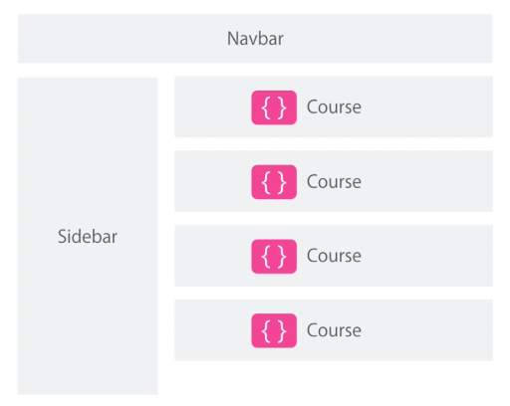
Components
  Component example:

Slide 5
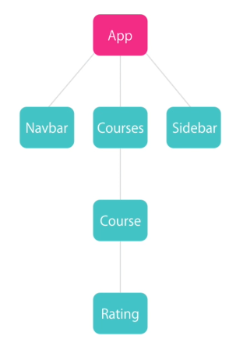
Components
  Component example:

Slide 6
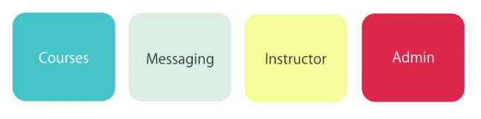
Components
  Modules:

Slide 7
Components
  What are the Alternatives?
  Create a component
  Register it in a module
  Add an element in an HTML markup

Slide 8
Demo
  ng new hello-world
  ng serve -o
  ng g c courses
  Add Components:
  add <app-courses> to app.component.html
  Add Directives:
  add *ngFor to courses.component.html

Slide 9
Demo
  Add Service:
  ng g s service/courses
  Dependency Injection:
  add service to constructor of courses.component.html
  let service = new CoursesService();
  this.courses = service.getCourses();

Slide 10
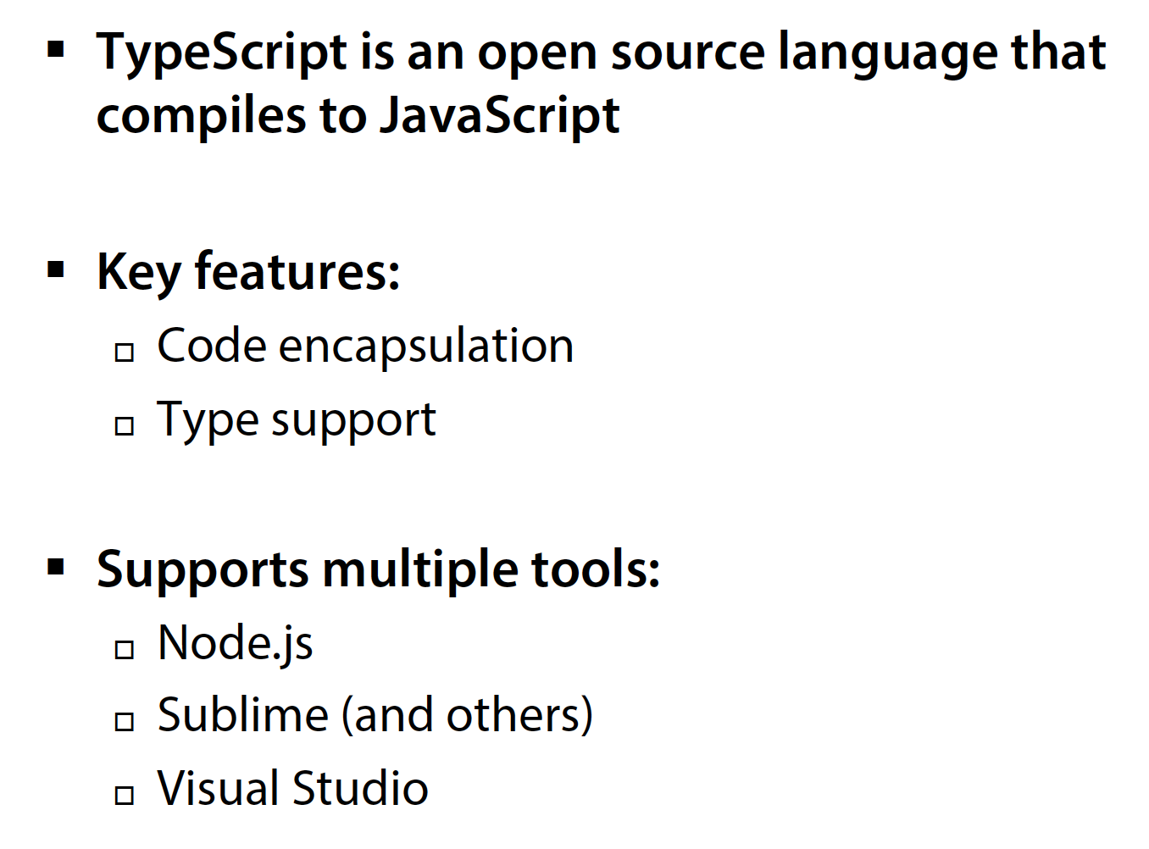
Summary

